Slide 1
SMARTCUBE “Your Personalized TV Experience”
Notes:
Difference to Pipe.com
CH & EU Fokus
No marketplace but directly lending out. It’s not a 2-sided market

Slide 2
Problem
Most people are unsatisfied with their TV recommendations …
… because only their viewing history and ratings are considered
... but not their current mood or social interactions

Slide 3





Solution
SMARTCUBE: Define your current TV mood and get better personalized recommendations
Save Time
Spare your Nerves
Enjoy more

Slide 4

Product Use Case

Slide 5
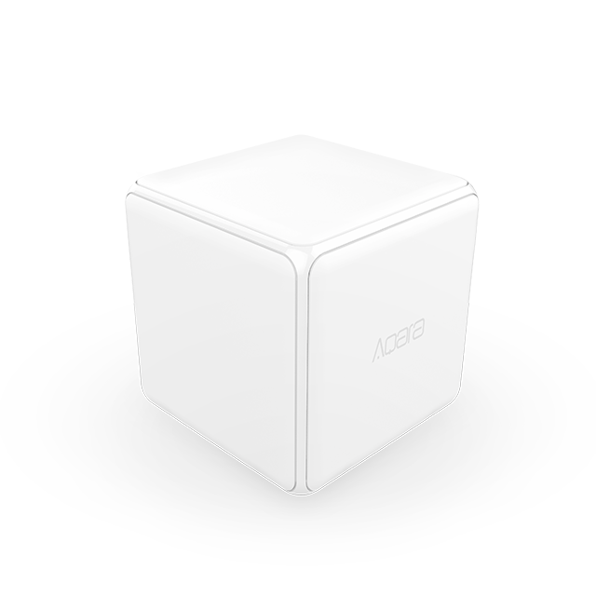


Product Technology
User
SMARTCUBE
ML Algorithm
Recommen-dation
Sport Category
User data
Sport
1. Recommendation
2. Recommendation
Sharknado
Action
Algorithm
3. Recommendation
…
Similar Users
User chooses category by turning Cube
Cube identifies which category was selected and sends signal to recommendation engine
ML algorithm takes User data (e.g. favorite sports club) and similar users into account
Algorithm generates priority list of recommendations

Slide 6
Market Validation
64%
of people use personalized TV recommendation engines
79%
of them are unsatisfied with their TV recom-mendations¹
67%
would use a mood depicting device to improve the recommendations
Note: Data based on survey conducted at Start Summit (n=33)
1: Rated the recommendations with 3 or less out of 5

Slide 7




Outlook potential
A soon as the customer is locked in, the potential of the SMARTCUBE is limitless:
From TV recommendations...
... over social interaction …
.. to a smart home device
Action
Sport

Slide 8




Team
Kay Erik Jenß
Yves Görgen
Alex Rivoire
Tim Sulzer
Product & Technology
Business Development
Operations
Marketing

Slide 9
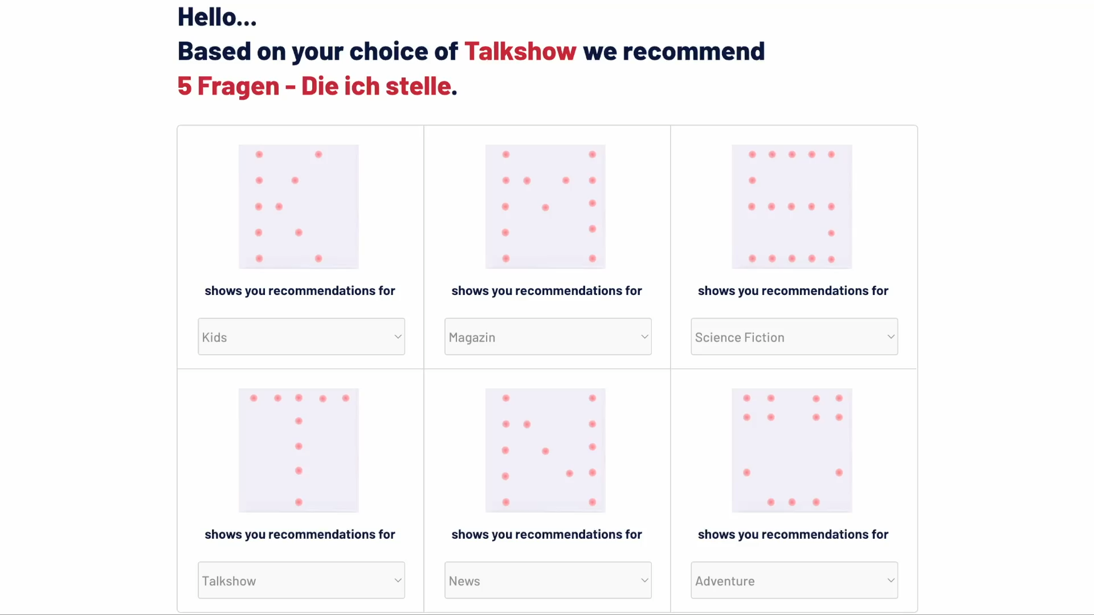
Backup
Recommendation Demo
Recommendation engine
Our engine is based on the open-source platform from Metarank
Metarank is a pre-trained recommendation engine which can be accessed in real-time to personalize the listings
Integration: Define features with simple YAML configuration file and send historical events and metadata via a JSON API
Demo: https://demo.metarank.ai

